Slide 1


ERODE SENGUNTHAR ENGINEERING COLLEGE (AN AUTONOMOUS INSTITUTION) PERUNDURAI, ERODE-638507
DEPARTMENT OF M.TECH (COMPUTER SCIENCE AND ENGINEERING)
WEATHER PREDICTION USING MACHINE LEARNING AND IOT
ZEROTH REVIEW
BATCH.NO: 13
UNDER THE GUIDANCE OF
MR.LOGANATHAN E
Asst. Professor / CSE
PRESENTED BY
ROHEETH B (730421553031)
SURIYAPRASATH B (730421553038)
YOGESH K (730421553044)
1

Slide 2
Machine learning AND IOT
DOMAIN
Machine learning is a subset of artificial intelligence that involves training algorithms to make predictions or decisions based on data, without being explicitly programmed.
IoT, or the Internet of Things, refers to the network of interconnected physical devices (such as sensors, appliances, and vehicles) that can collect and exchange data over the internet.

Slide 3
ABSTRACT
This project develops an automated weather prediction system using Arduino and DHT-11 sensors to collect environmental data. Machine learning techniques are applied to predict rain probability with significant accuracy.
Predictions are disseminated to users via automated emails, enhancing the timeliness and relevance of weather updates. The system is programmed to execute tasks on a fixed daily schedule, ensuring regular data processing and communication.
Error handling and logging are integrated for robustness and ease of troubleshooting. Security of sensitive data and compliance with email regulations are prioritized. User feedback is utilized to improve the service, while scalability and maintenance are planned for system longevity.

Slide 4



Slide 5
ERODE SENGUNTHAR ENGINEERING COLLEGE (AN AUTONOMOUS INSTITUTION) PERUNDURAI, ERODE-638507
DEPARTMENT OF M.TECH (COMPUTER SCIENCE AND ENGINEERING)
WEATHER PREDICTION USING MACHINE LEARNING AND IOT
FIRST REVIEW
BATCH.NO: 13
UNDER THE GUIDANCE OF
MR.LOGANATHAN E
Asst. Professor / CSE
PRESENTED BY
ROHEETH B (730421553031)
SURIYAPRASATH B (730421553038)
YOGESH K (730421553044)

Slide 6
List Of Modules
Using Arduino IDE and DHT-11 sensor for date collection.
Weather Prediction using Machine Learning Models.
Analyzing Rain Probability.
Sending Mails to Customers using Mailing API.
Scheduling time.

Slide 7
Hardware Requirements: DHT-11 sensor for temperature and humidity, Arduino board
Software Requirements:Operating System, IoT Sensor Firmware, Data Analysis and ML Software, Database Management System.
Data Requirements: Historical Weather Data, Real-time data collected from the DHT-11 sensor.

Slide 8
WORKFLOW
Data Collection: IoT sensors gather real-time weather data.
Data Transmission: Data is sent to a central server for processing.
Data Preprocessing: Raw data is cleaned and transformed.
Machine Learning: ML models are trained on historical data and fine-tuned with real-time data.
Weather Forecasting: Models provide weather forecasts and severe weather event predictions.
Alerting System: Alerts are sent when severe weather events are detected.

Slide 10
ERODE SENGUNTHAR ENGINEERING COLLEGE (AN AUTONOMOUS INSTITUTION) PERUNDURAI, ERODE-638507
DEPARTMENT OF M.TECH (COMPUTER SCIENCE AND ENGINEERING)
WEATHER PREDICTION USING MACHINE LEARNING AND IOT
SECOND REVIEW
BATCH.NO: 13
UNDER THE GUIDANCE OF
MR.LOGANATHAN E
Asst. Professor / CSE
PRESENTED BY
ROHEETH B (730421553031)
SURIYAPRASATH B (730421553038)
YOGESH K (730421553044)
1

Slide 11
LITERATURE REVIEW
S.NO | TITLE | AUTHOR | YEAR | METHODOLOGY
1 | Effect Of Weather Condition On Lora Iot Communication Technology In A Tropical Region: Malaysia | OLAKUNLE ELIJAH SHARUL KAMAL ABDUL RAHIM VITAWAT SITTAKUL | 2021 | Arduino application framework
2 | Development of a Cost-Effective IoT-Based Weather Monitoring System | DEBASHISH MOHAPATRA BIDYADHAR SUBUDHI | 2023 | IoT server architecture​
3 | IoT-Based Data Logger for Weather Monitoring Using Arduino-Based Wireless Sensor Networks with Remote Graphical Application and Alerts | JAMAL MABROUKI MOURADE AZROUR DRISS DHIBA | 2021 | Arduino-based sensor framework

Slide 12
S.NO | TITLE | AUTHOR | YEAR | METHODOLOGY
4 | Using Long Short-Term Memory (LSTM) and Internet of Things (IoT) for Localized Surface Temperature Forecasting in an Urban Environment | MANZHU YU FANGCAO XU WEIMING HU JIAN SUN1 GUIDO CERVONE | 2021 | LSTM sequential data learning​
5 | When Weather Matters: IoT-Based Electrical Load Forecasting for Smart Grid | R.DE GAUDENZI P. ANGELETTI, D. PETROLATI | 2023 | Two-step load forecasting

Slide 13
Using Arduino IDE and DHT-11 sensor for date collection.
Weather Prediction using Machine Learning Models.
Analyzing Rain Probability.
Sending Mails to Customers using Mailing API.
Scheduling time .

Slide 14
USING ARDUION IDE AND DHT-11 SENSOR FOR DATE COLLECTION
You're using an Arduino with a DHT-11 sensor to collect temperature and humidity data. Ensure you have the correct libraries installed in the Arduino IDE to interface with the DHT-11 sensor.
Data read from the sensor will need to be sent to the computer where your Python script is running. This can be done over a serial connection.
Make sure your Arduino code is correctly reading the sensor values and sending them in a format that your Python script expects.

Slide 15
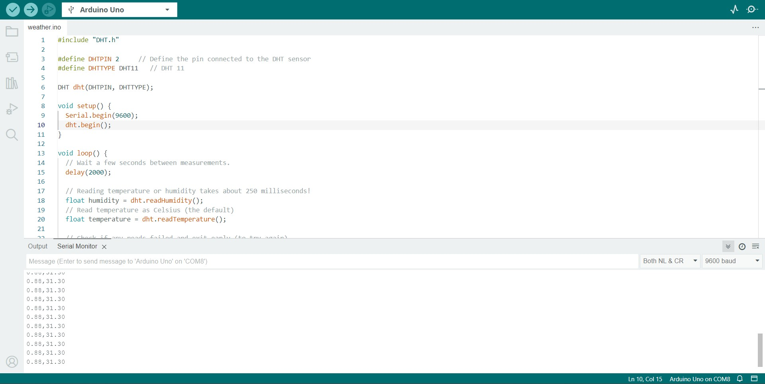
Module-I

Slide 16
WEATHER PREDICTION USING MACHINE LEARNING MODELS
With the data collected from the DHT-11 sensor, you're using machine learning models to predict weather conditions, such as temperature, humidity, or even the weather summary (e.g., sunny, cloudy, rainy).
Ensure that your model is trained with a comprehensive dataset that represents the weather patterns you're trying to predict.
Validate the performance of your model to ensure its predictions are reliable.

Slide 17
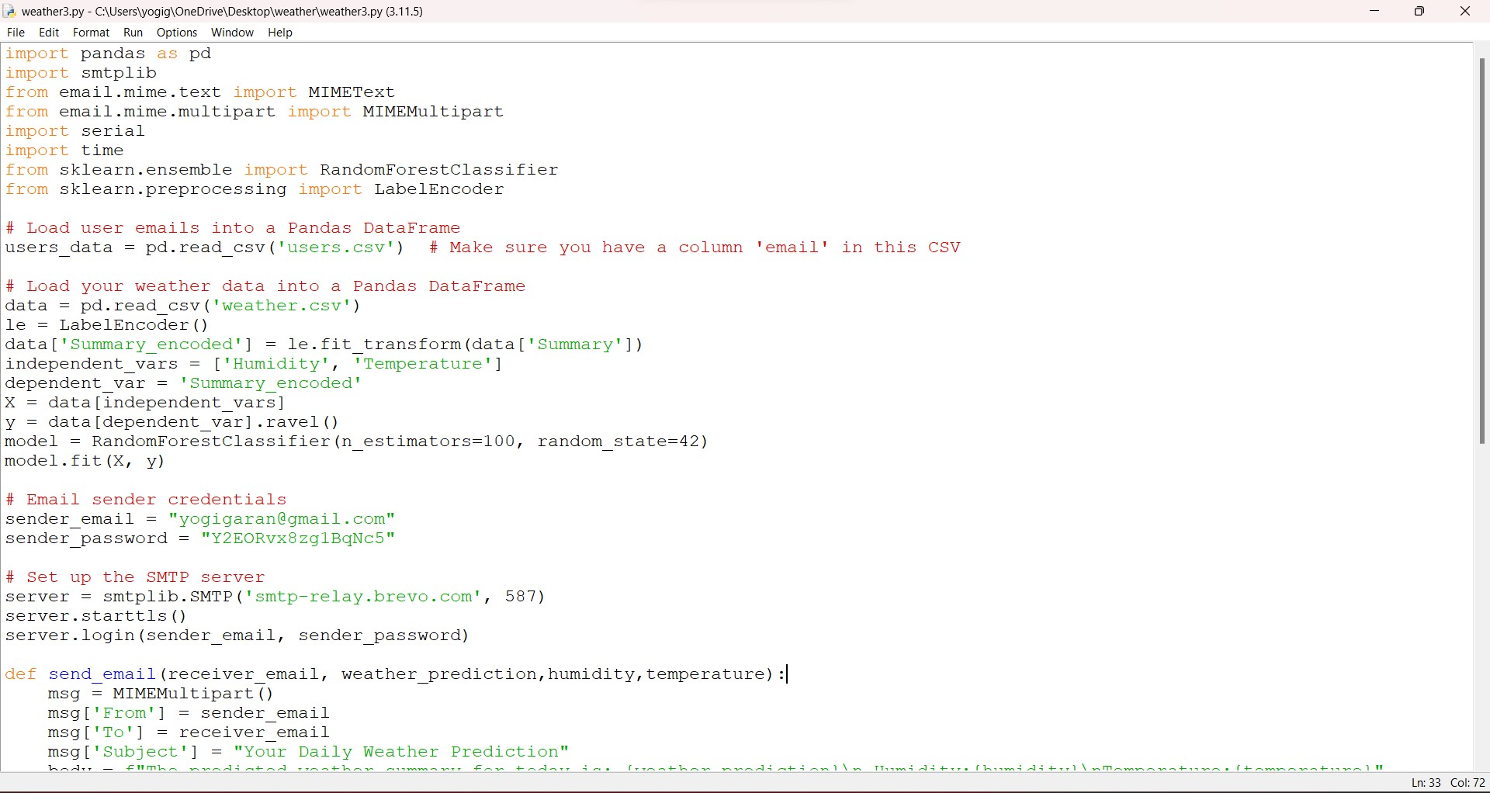
Module-II

Slide 18
ANALYZING RAIN PROBABILITY
This part likely involves using the predictions from your machine learning model to assess the probability of rain.
It's important to have a model that is specifically trained to predict precipitation or to interpret the model outputs to estimate rain probability.

Slide 19
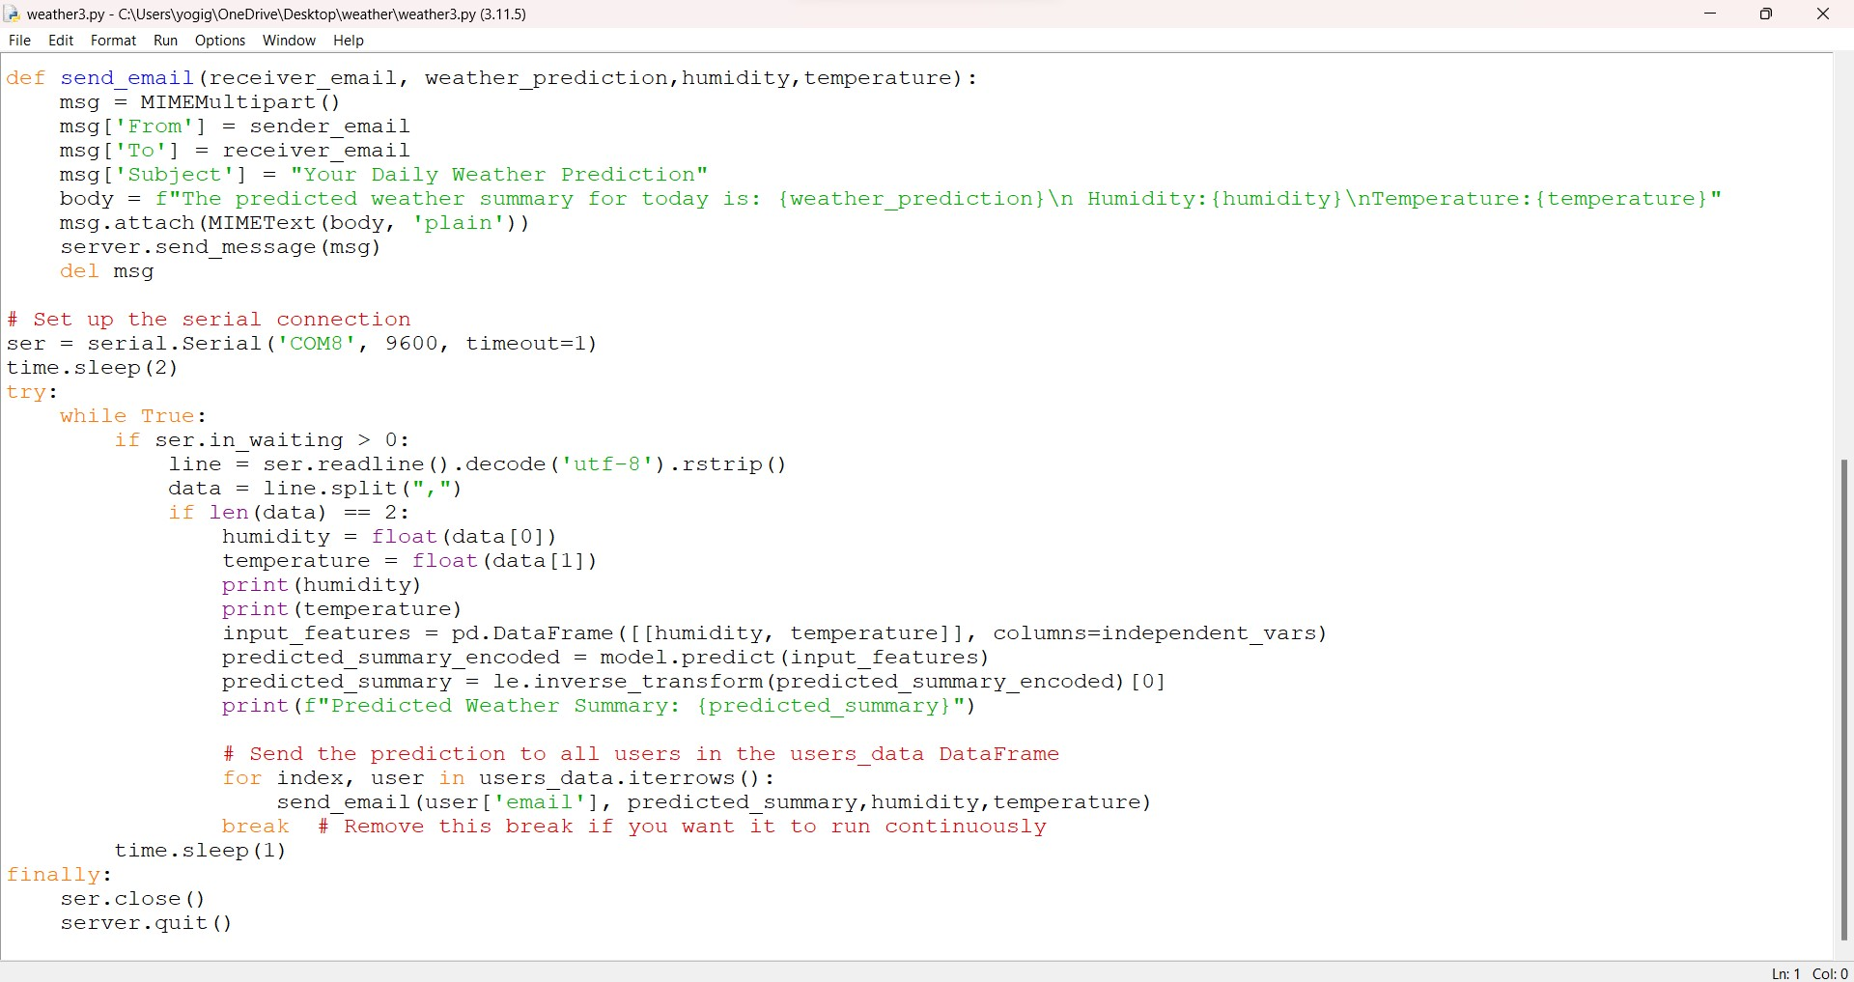
Module-III

Slide 20
SCHEDULING TIME
You want to schedule the weather prediction and emailing process to run automatically at a certain time each day.
Consider using a task scheduler like cron for Linux/macOS or Task Scheduler for Windows to trigger your script.
Alternatively, you can use the schedule Python package to handle in-script scheduling if the script will be running continuously

Slide 21
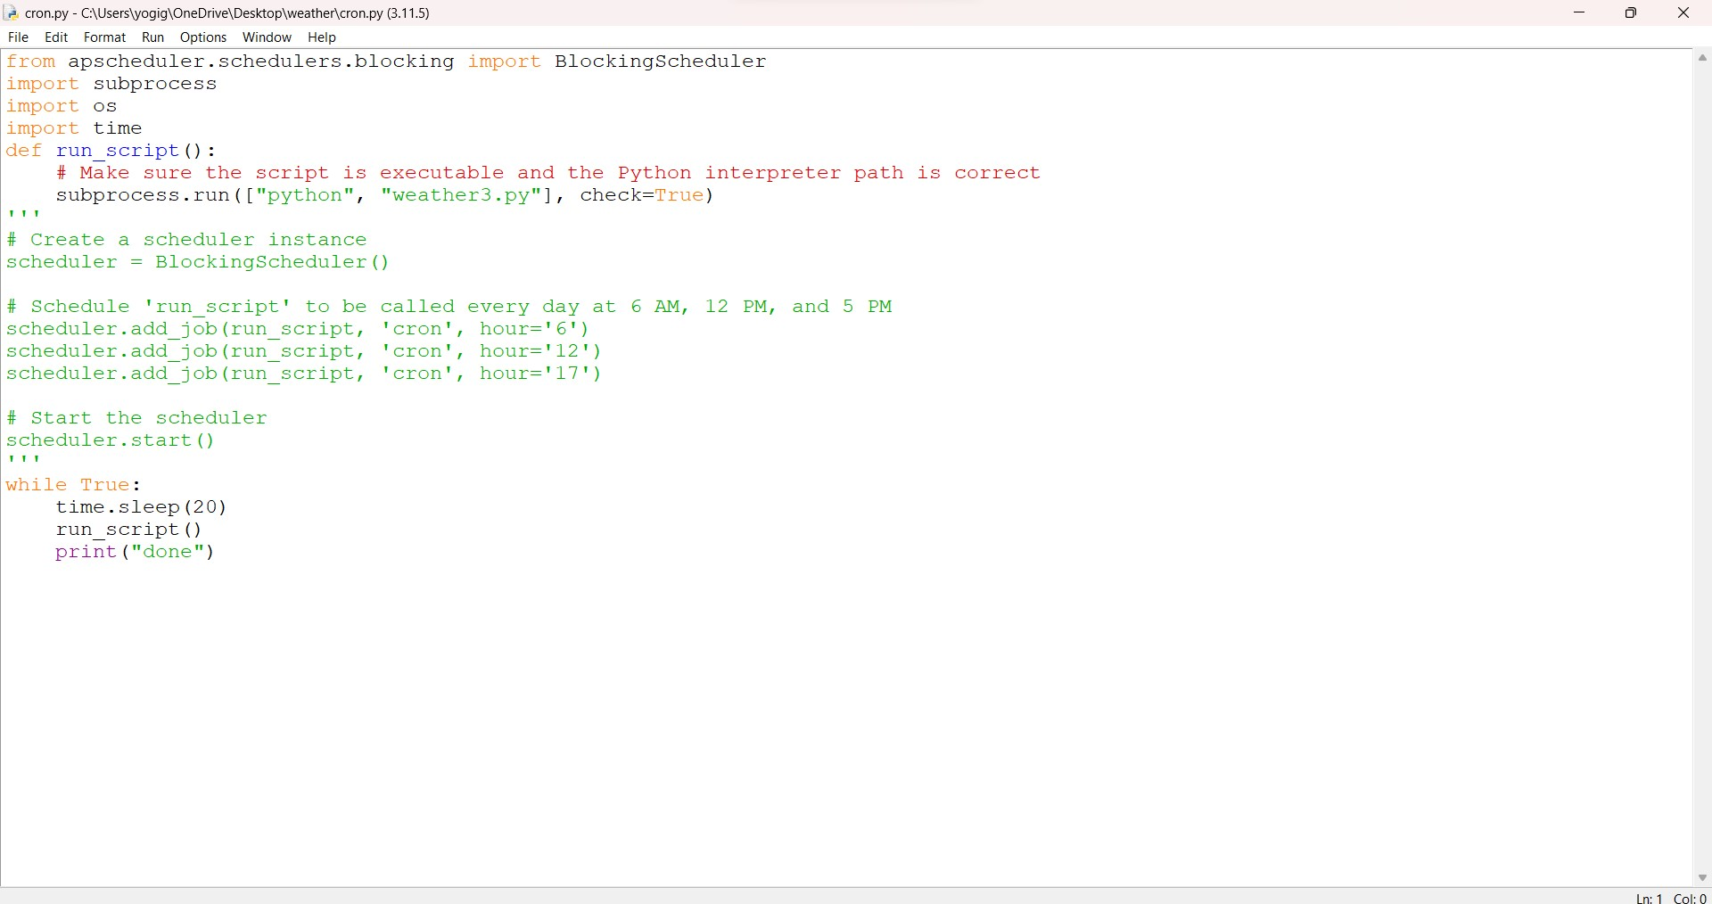
Module-IV

Slide 22
SENDING MAILS TO CUSTOMERS USING MAILING API
You're planning to use an email API or SMTP server to send out weather predictions to a list of subscribers.
Ensure that you comply with email regulations such as GDPR or CAN-SPAM Act, meaning you should have consent from the recipients to send them emails, and you should provide a way for them to unsubscribe.
Handle your SMTP credentials securely, and consider using an environment variable or a secure app to store them.

Slide 23
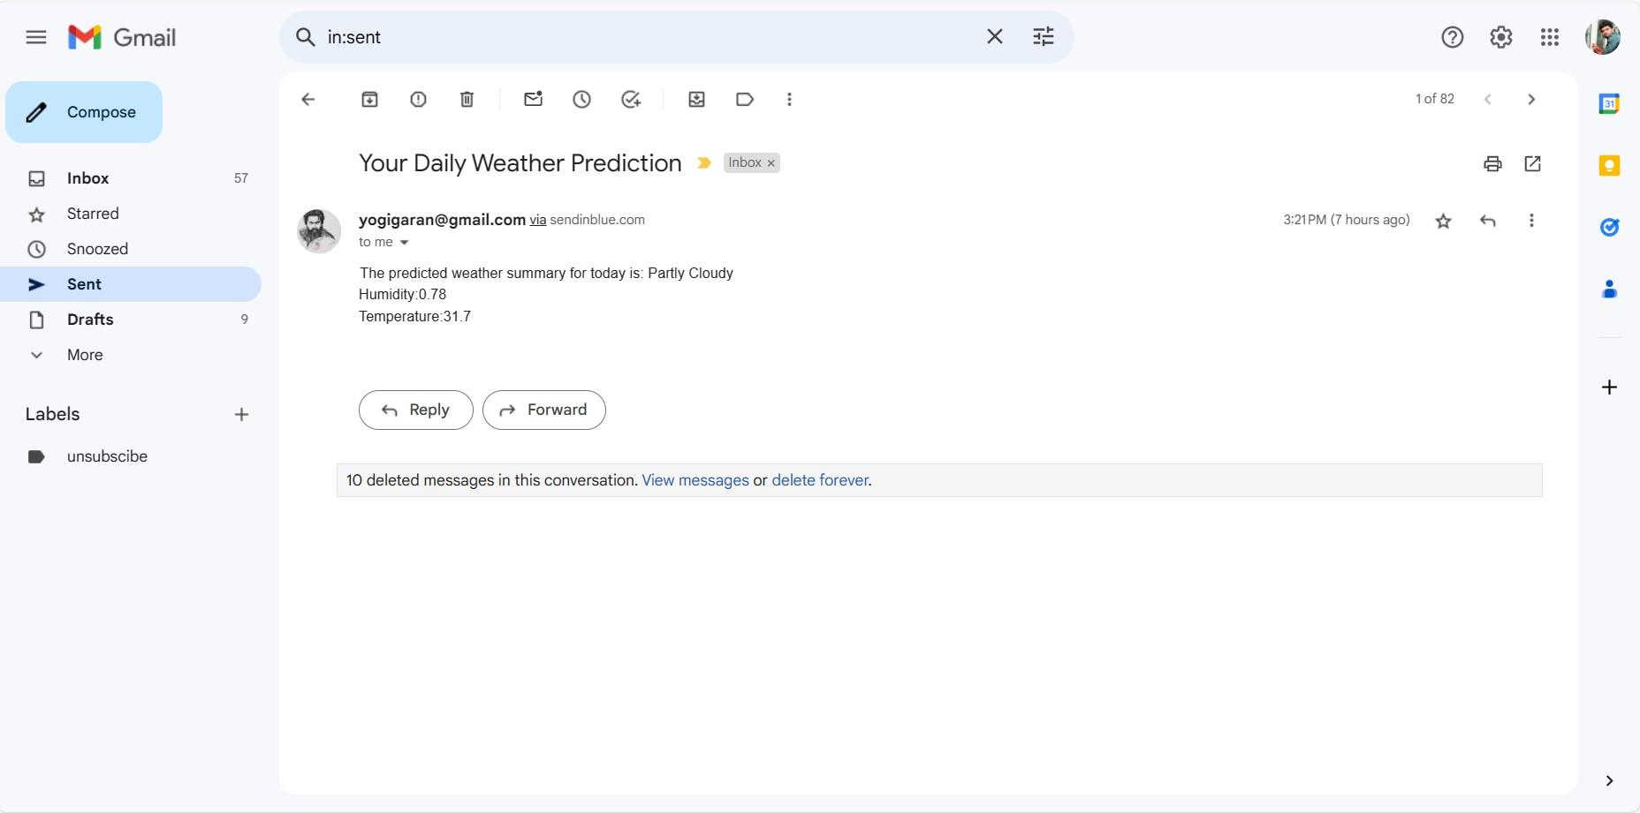
Module-V

